Slide 1
Discrete Mathematics
CS 2610
March 17, 2024

Slide 2
Number Theory
Temel sayı teorisi, genellikle tam sayılar ve bu sayıların özellikleri veya rasyonel sayılarla ilgilenir.
Özellikle tam sayılar arasındaki bölünebilirlik konularını ele alır.
Uygulama Alanları: Kriptografi, E-ticaret, Ödeme Sistemleri, Rastgele Sayı Üretimi, Kodlama Teorisi, Hash Fonksiyonları.
Some Applications
  Cryptography
    E-commerce
    Payment systems
    …
  Random number generation
  Coding theory
  Hash functions (as opposed to stew functions ☺)

Slide 3
Number Theory - Division
Let a, b and c be integers, st a≠0, we say that
“a divides b” or a|b if there is an integer c where
b = a·c .
a and c are said to divide b (or are factors)
a | b ∧ c | b
b is a multiple of both a and c
Example:
5 | 30 and 5 | 55 but 5 | 27

Slide 4
Number Theory - Division
Theorem 3.4.1: for all a, b, c ∈ Z:
  1. a|0
  2. (a|b ∧ a|c) → a | (b + c)
  3. a|b → a|bc for all integers c
  4. (a|b ∧ b|c) → a|c
Proof: (2) a|b means b = ap, and a|c means c = aq
b + c = ap + aq = a(p + q)
therefore, a|(b + c), or (b + c) = ar where r = p+q
Proof: (4) a|b means b = ap, and b|c means c = bq
c = bq = apq
therefore, a|c or c = ar where r = pq

Slide 5
Division
Remember long division?
3
30
109
90
19
109 = 30·3 + 19
a = dq + r (dividend = divisor · quotient + remainder)

Slide 6
The Division Algorithm
Division Algorithm Theorem: Let a be an integer, and d be a positive integer. There are unique integers q, r with r ∈ {0,1,2,…,d-1} (ie, 0 ≤ r < d) satisfying
a = dq + r
d is the divisor (bölen)
q is the quotient (bölüm)
q = a div d
r is the remainder (kalan)
r = a mod d

Slide 7
Mod Operation
Let a, b ∈ Z with b > 1.
a = q·b + r, where 0 ≤ r < b
Then a mod b denotes the remainder r from the division “algorithm” with dividend a and divisor b
109 mod 30 = ?
0 ≤ a mod b ≤ b – 1

Slide 8
Modular Arithmetic
Let a, b ∈ Z, m ∈ Z⁺
Then a is congruent (denk) to b modulo m iff m | (a −b) .
Notation:
  “a ≡ b (mod m)” reads a is congruent to b modulo m
  “a ≡ b (mod m)” reads a is not congruent to b modulo m.
Examples:
  5 ≡ 25 (mod 10)
  5 ≡ 25 (mod 3)

Slide 9
Modular Arithmetic
Theorem 3.4.3: Let a, b ∈ Z, m ∈ Z⁺. Then
a ≡ b (mod m) iff a mod m = b mod m
Proof: (1) given a mod m = b mod m we have
a = ms + r or r = a – ms,
b = mp + r or r = b – mp,
a – ms = b – mp
which means a – b = ms – mp
= m(s – p)
so m | (a – b) which means
a ≡ b (mod m)

Slide 10
Modular Arithmetic
Theorem 3.4.3: Let a, b ∈ Z, m ∈ Z⁺. Then
a ≡ b (mod m) iff a mod m = b mod m
Proof: (2) given a ≡ b (mod m) we have m | (a – b)
let a = mq_{a} + r_{a} and b = mq_{b} + r_{b}
so, m|((mq_{a} + r_{a}) – (mq_{b} + r_{b}))
or m|m(q_{a} – q_{b}) + (r_{a} – r_{b})
recall 0 ≤ r_{a} < m and 0 ≤ r_{b} < m
therefore (r_{a} – r_{b}) must be 0
that is, the two remainders are the same
which is the same as saying
a mod m = b mod m

Slide 11
Modular Arithmetic
Theorem 3.4.4: Let a, b ∈ Z, m ∈ Z⁺. Then:
a ≡ b (mod m) iff there exists a k ∈ Z st
a = b + km.
Proof: a = b + km means
a – b = km which means
m | (a – b) which is the same as saying
a ≡ b (mod m)
(to complete the proof, reverse the steps)
Examples:
27 ≡ 12 (mod 5) 27 = 12 + 5k k = 3
105 ≡ -45 (mod 10) 105 = -45 + 10k k = 15

Slide 12
Modular Arithmetic
Theorem 3.4.5: Let a, b, c, d ∈ Z, m ∈ Z⁺. Then if
a ≡ b (mod m) and c ≡ d (mod m), then:
  a + c ≡ b + d (mod m),
  a - c ≡ b - d (mod m),
  ac ≡ bd (mod m)
Proof: a = b + k₁m and c = d + k₂m
a + c = b + d + k₁m + k₂m
or a + c = b + d + m(k₁ + k₂)
which is
a + c ≡ b + d (mod m)
others are similar

Slide 13
Modular Arithmetic - examples
Hash Functions: record access scheme for finding a record very quickly based on some key value in the record. That is, there is a mapping between the key value and the memory location for the record.
Ex. h(k) = k mod m (an onto (örten) function, why?)
k is the record’s key value
m is the number of memory locations
Collisions occur since h is not one-to-one (birebir). What then? Typically, invoke a secondary hash function or some other scheme (sequential search).
f(a)=3 ve f(b)=3 ise hash funct. Linked list ile bağlıyorsun genellikle

Slide 14
Modular Arithmetic - examples
Pseudorandom numbers: generated using the linear congruential method (doğrusal eşlik metodu)
m – modulus a - multiplier
c – increment x₀ – seed
2 ≤ a < m, 0 ≤ c < m, 0 ≤ x₀ < m
Generate the set of PRNs {x_{n}},asal sayı, with 0 ≤ x_{n} < m for all n
X_{n+1} = (aX_{n} + c) mod m
(divide by m to get PRNs between 0 and 1)

Slide 15
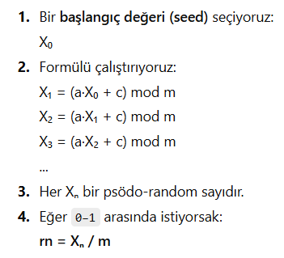
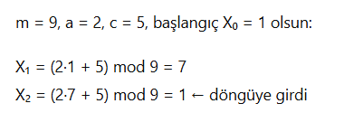
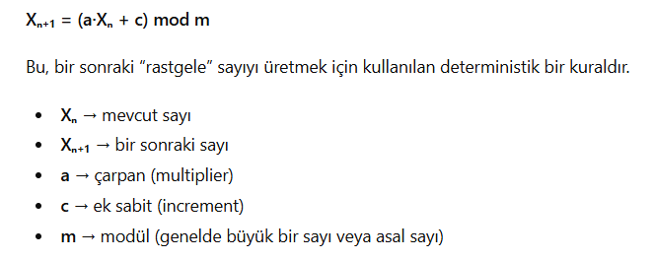
Pseudonumber

Slide 16
Modular Arithmetic - examples
cryptology: secret codes, encryption/decryption
Caesar encryption (positional 3-offset scheme)
For our 26 letters, assign integers 0-25
f(p) = (p + 3) mod 26
“PARK” maps to integers 15, 0, 17, 10 which are then
encrypted into 18, 3, 20, 13 or “SDUN”
use the inverse (p – 3)mod26 to decrypt back to “PARK”

Slide 17
Number Theory – Primes (Asal)
A positive integer n > 1 is called prime if it is only divisible by 1 and itself (i.e., only has 1 and itself as its positive factors).
Example: 2, 3, 5, 7, 11, 13, 17, 19, 23, 29, 31, 97
A number n ≥ 2 which isn’t prime is called composite. (Iff there exists an a such that a|n and 1 < a < n)
Example:
All even numbers > 2 are composite.
By convention, 1 is neither prime or composite (birleşik sayı).

Slide 18
Number Theory - Primes
Fundamental Theorem of Arithmetic
Tüm birleşik sayıları asal sayıların artan sıralı çarpımı cinsinden gösterebiliriz
Examples:
    2 = 2
    4 = 2·2
    100 = 2·2·5·5
    200 = 2·2·2·5·5
    999= 3·3·3·37

Slide 19
Number Theory – Primality Testing
How do you check whether a positive integer n is prime?
Solution:
  Start testing to see if prime p divides n (2|n, 3|n, 5|n,
  etc). When one is found, use the dividend and begin again. Repeat.
  Find prime factorization for 7007.
  2, 3, 5 don’t divide 7007 but 7 does (1001)
  Now, 7 also divides 1001 (143)
  7 doesn’t divide 143 but 11 does (13) and we’re done.

Slide 20
Number Theory - Primes
Theorem 3.5.2 : If n is composite, then it has a prime factor (divisor) that is less than or equal to √n
Proof: if n is composite, we know it has a factor a with
1 < a < n. IOW n = ab for some b > 1. So, either a ≤ √n or
b ≤ √n (note, if a > √n and b > √n then ab > n, nope). OK,
both a and b are divisors of n, and n has a positive
divisor not exceeding √n. Bu bölen ya asaldır ya da kendisinden küçük bir asal böleni vardır. Her iki durumda da n'nin ≤ √n asal böleni vardır.
*** Bir tamsayı, kareköküne eşit veya daha küçük herhangi bir asal sayıya bölünemiyorsa asaldır.

Slide 21
Number Theory – Prime Numbers
Theorem 3.5.4: The number of primes not exceeding n is asymptotic to n/log n .
i.e. lim_{n→∝} Π(n)/(n log n) → 1, doğal logaritma
1000/math.log(1000). Pi(n) gerçekte ilgili sayıya kadar olan asal sayı adedi
Π(n): number of prime numbers less than or equal to n
n
1000
10000
100000
1000000
10000000
100000000
Π(n)
168
1229
9592
78498
664579
5761455
n/log n
145
1086
8686
72382
620420
5428681

Slide 22
Number Theory – Prime Numbers
There are still plenty of things we don’t know about
primes:
* no cool function gives us primes, not even
f(n) = n² – n + 41
* Goldbach’s conjecture (varsayım) : every even
integer n where n > 2 is the sum of two primes (18=13+5 ; 24= 19+5; 32=29+3)
* twin prime conjecture: there are infinitely many
twin primes (ikiz asal) (pairs p and p+2, both prime 5 ve 7 gibi)

Slide 23
Greatest Common Divisor (ortak bölenlerin en büyüğü, obeb)
Let a, b be integers, a≠0, b≠0, not both zero.
The greatest common divisor of a and b is the biggest number d which divides both a and b.
Example: gcd(42,72)
Positive divisors of 42: 1,2,3,6,7,14,21
Positive divisors of 72: 1,2,3,4,6,8,9,12,24,36
gcd(42,72)=6

Slide 24
Finding the GCD
If the prime factorizations are written as
and ,
then the GCD is given by:
a
=
p
a
p
a
…
p
a
b
=
p
b
p
b
…
p
b
1
2
n
1
2
n
1
2
n
1
2
n
gcd(
a
,
b
)
=
p
min(
a
,
b
)
p
min(
a
,
b
)
…
p
min(
a
,
b
)
.
1
1
2
2
n
n
1
2
n
Example:
  a = 42 = 2 · 3 · 7 = 2¹ · 3¹ · 7¹
  b = 72 = 2 · 2 · 2 · 3 · 3 = 2³ · 3² · 7⁰
  gcd(42, 72) = 2¹ · 3¹ · 7⁰ = 2·3 = 6

Slide 25
Least Common Multiple (ortak katların en küçüğü, okek)
a ve b tarafından ortak bölünebilen en küçük sayıya ortak katların en küçüğü denir
Example: lcm(2³3⁵7², 2⁴3³) = 2⁴3⁵7²
lcm(
a
,
b
)
=
p
max(
a
,
b
)
p
max(
a
,
b
)
…
p
max(
a
,
b
)
.
1
1
2
2
n
n
1
2
n

Slide 26
Least Common Multiple
Let a and b be positive integers. Then
ab = gcd(a, b) · lcm(a, b)

Slide 27
Modular Exponentiation
Let b be base, n, m large integers, b < m.
«b» taban, «n» ve «m» büyük sayılar olsun, b<m
The modular exponentiation is computed as
b^{n} mod m
Fundamental in cryptography: RSA encryption
How can we compute the modular exponentiation ?

Slide 28
Modular Exponentiation
For large b, n and m, we can compute the modular exponentiation using the following property:
a·b mod m = (a mod m) (b mod m) mod m
(Mod5)91= 13*7 = 3*2 (mod 5)=1
Therefore, b^{n} (mod m) = (b mod m)^{n} (mod m)
In fact, we can take (mod m) after each multiplication to keep all values low.

Slide 29
Example
Find 37⁵ (mod 5)
37⁵ (mod 5) = (37(mod 5))⁵ (mod 5) = 2⁵ (mod 5)
2⁵ (mod 5) = 2*2*2*2*2 (mod 5) = 4*2*2*2 (mod 5) =
8*2*2 (mod 5) = 3*2*2 (mod 5) = 6*2 (mod 5) =
1*2 (mod 5) = 2 (mod 5) = 2
Can you see a way to shorten this process?
Use results you have already calculated
2⁵ (mod 5) = 4*4*2 (mod 5) = 16*2 (mod 5) = 2
For large exponents this can make a big difference!

Slide 30
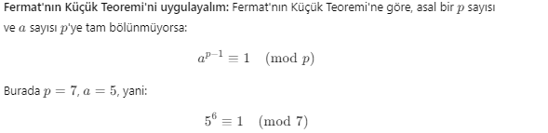
örnekler
3^2000 mod 20 =? 1?
33^125 mod 7=?

Slide 31
Cryptography
Cryptology is the study of secret (coded) messages.
  Cryptography – Methods for encrypting (şifreleme) and decrypting (şifre çözme) secret messages using secret keys.
    Encryption,şifreleme, is the process of transforming a message to an unreadable form.
    Decryption, çözümleme, is the process of transforming an encrypted message back to its original form.
    Both encryption and decryption require the use of some secret knowledge known as the secret key.
  Cryptoanalysis – Methods for decrypting an encrypted message without knowing the secret keys.

Slide 32
Cryptography - Caesar’s shift cypher
Encryption
  Shift each letter in the message three letters forward in the alphabet.
Decryption
  Shift each letter in the message three letters backward in the alphabet.
hello world
khoor zruog
A | B | C | D | …… | X | Y | Z
Decryption
Encryption
D | E | F | G | …… | A | B | C

Slide 33
Public Key Cryptography
Public key cryptosystems use two keys
  Public key to encrypt the message
    Known to everybody
  Private Key to decrypt the encrypted message (şifreyi çözmek için kullanılan ve sadece yetkili kişide olan gizli anahtar)
    It is kept secret.
    It is computationally infeasible to guess the Private Key
RSA one of the most widely used Public key cryptosystem
Ronald Rivest, Adi Shamir, and Leonard Adleman

Slide 34
RSA Basis
Let p and q be two large primes, and e ∈ Z such that
gcd(e,(p-1)(q-1)) = 1
and d (the decryption key) is an integer such that
de ≡ 1 (mod (p-1)(q-1))
p and q are large primes,over 100 digits each.
Public Key
  n=pq (the modulus)
  e (the public exponent)
  It is common to choose a small public exponent for the public key.
Private Key
  d (the private exponent)

Slide 35
RSA
Encryption
  Let M be a message such that M < n
  Compute C=Me mod n
    This can be done using Binary Modular Exponentiation
Decryption
  Compute M = C^{d} (mod pq)

Slide 36
Why Does RSA Work?
RSA yönteminin doğruluğu, ne p ne de q'nun M'yi bölmediği varsayımından (ki bu çoğu mesaj için doğru olacaktır) ve aşağıdaki iki teoremden kaynaklanmaktadır.
1.Fermat’s Little Theorem
    If p is a prime and a is an integer not divisible by p-1 then a^{p-1} ≡ 1 (mod p).
    P=7, a= 9, 9^6 (mod 7)= 2^6 (mod7)=1
2. The Chinese Remainder Theorem
    Let m₁, m₂, …, m_{n} be pairwise relatively prime positive integers. The system (aralarında asal)
    x ≡ a₁ (mod m₁) x ≡ a₂ (mod m₂) … x ≡ a_{n} (mod m_{n})
    has a unique solution modulo m₁ m₂ … m_{n} – i.e., there is only one x such that 0 ≤ x < m₁ m₂ … m_{n} that satisfies the above congruencies.(yukardaki eşitlikleri)

Slide 37
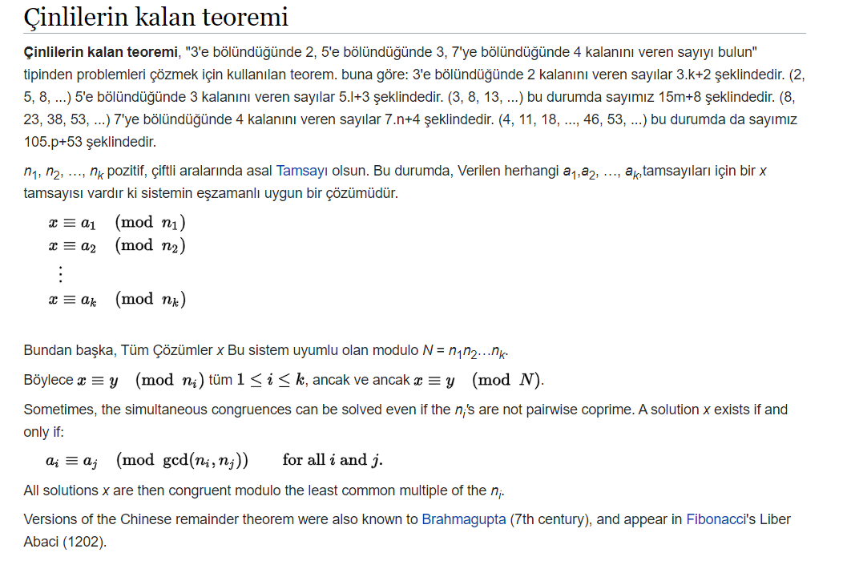
Çinli Kalan Teoremi

Slide 38
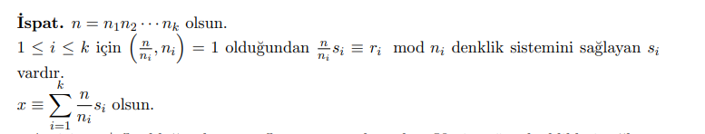
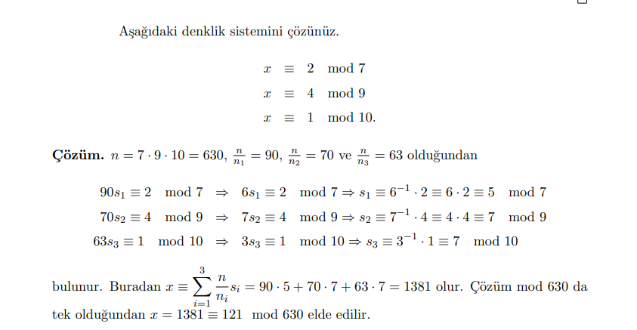
Çinli Kalan Teoremi

Slide 39
Why Does RSA Work?
Since de ≡ 1 (mod (p-1)(q-1)), we can conclude that de=1+k(p-1)(q-1).
Therefore C^{d} ≡ (Me)^{d} = Mde= M^{1+k(p-1)(q-1)} (mod n).
Assuming gcd(M,p) = gcd(M,q) = 1, we can conclude (by Fermat’s Little Theorem) that. M, p-1’e tam bölünmüyor (1 kalıyor)
  C^{d} ≡ M·(M^{p-1})^{k(q-1)} ≡ M·1 ≡ M (mod p)
  C^{d} ≡ M·(M^{q-1})^{k(p-1)} ≡ M·1 ≡ M (mod q)
By the Chinese Remainder Theorem, we can conclude that
  C^{d} ≡ M (mod pq)
    Recall that n = pq

Slide 40
RSA Example
Let p = 61 and q = 53
  Then n = pq = 3233
Let e = 17 and d = 2753
  de ≡ 1 (mod (p-1)(q-1))
  Note 17 * 2753 = 46801 = 1+ 15*60*52
Public keys: e, n
Private key: d
Encrypt 123
  123¹⁷(mod 3233) = 855
Decrypt 855
  855 ²⁷⁵³(mod 3233) = 123 , tek bir d var bunu sağlayan
We need clever exponentiation techniques!

Slide 41
Breaking RSA
How to break the system
An attacker discovers the numbers p and q
  Find the prime factorization of n
  Computationally difficult when p and q are chosen properly.
  The modulus n must be at least 2048 bits long
    On May 10, 2005, RSA-200, a 200-digit number module was factored into two 100-digit primes by researchers in Germany
      The effort started during Christmas 2003 using several computers in parallel.
      Equivalent of 55 years on a single 2.2 GHz Opteron CPU

Slide 42
RSA – In practice
How to break the system
Find e-th roots mod n.
    The encrypted message C is obtained as
      C = Me mod n
    No general methods are currently known to find the e-th roots mod n, except for special cases.

Slide 43
Review of Secret Key (Symmetric) Cryptography
Confidentiality (gizlilik)
  stream ciphers (uses PRNG)
  block ciphers with encryption modes
Integrity (bütünlük)
  Cryptographic hash functions
  Message authentication code (keyed hash functions)
Limitation: sender and receiver must share the same key
  Needs secure channel for key distribution
  Impossible for two parties having no prior relationship
  Needs many keys for n parties to communicate

Slide 44
RSA Algorithm
Invented in 1978 by Ron Rivest, Adi Shamir and Leonard Adleman
  Published as R L Rivest, A Shamir, L Adleman, "On Digital Signatures and Public Key Cryptosystems", Communications of the ACM, vol 21 no 2, pp120-126, Feb 1978
Security relies on the difficulty of factoring large composite numbers
Essentially the same algorithm was discovered in 1973 by Clifford Cocks, who works for the British intelligence

Slide 45
RSA Public Key Crypto System
Key generation:
1. Select 2 large prime numbers of about the same size, p and q
  Typically each p, q has between 512 and 2048 bits
2. Compute n = pq, and Φ(n) = (q-1)(p-1)
3. Select e, 1<e< Φ(n), s.t. gcd(e, Φ(n)) = 1
  Typically e=3 or e=65537
4. Compute d, 1< d< Φ(n) s.t. ed ≡ 1 mod Φ(n)
  Knowing Φ(n), d easy to compute.
Public key: (e, n)
Private key: d

Slide 46
RSA Description (cont.)
Encryption
Given a message M, 0 < M < n M ∈ Z_{n}− {0}
use public key (e, n)
compute C = Me mod n C ∈ Z_{n}− {0}
Decryption
Given a ciphertext C, use private key (d)
Compute C^{d} mod n = (Me mod n)^{d} mod n = M^{ed} mod n = M

Slide 47
RSA Example
p = 11, q = 7, n = 77, Φ(n) = 60 ,((q-1)(p-1))
d = 13, e = 37 (ed = 481; ed mod 60 = 1)
  de ≡ 1 (mod (p-1)(q-1))
Let M = 15. Then C ≡ Me mod n
  C ≡ 15³⁷ (mod 77) = 71
M ≡ C^{d} mod n
  M ≡ 71¹³ (mod 77) = 15

